Slide 1
Level 2 Writing Booklet p. 6 -17

Slide 2
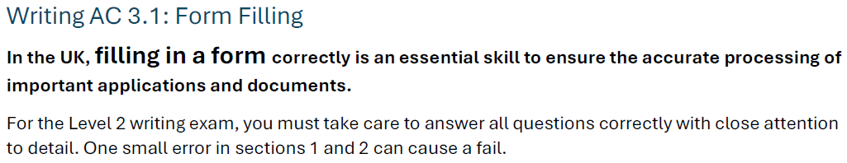

Slide 3
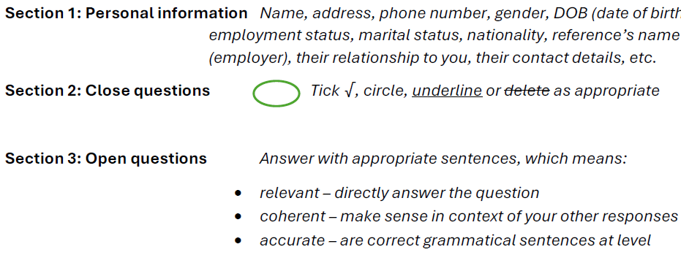

Slide 4
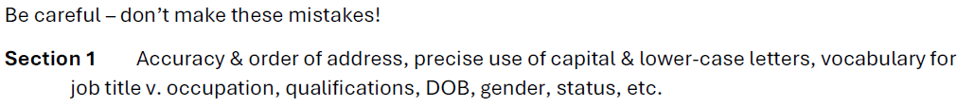
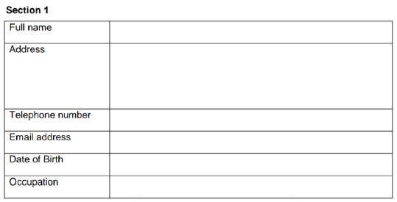

Slide 5
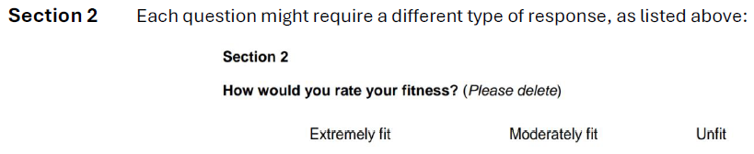

Slide 6
Section 3
Only those sentences that directly answer the question can be counted = relevant.
The responses need to fit in relation to other sections (i.e., if you gave a restaurant review 5 out of 5 stars earlier, your sentences should be positive about the quality) = coherent.
Sentences need to be grammatically correct. However, to improve your chances at success in this section, you are advised to use simple sentence structures. This will play it safe and count more sentences in total giving you better chances.
Sentences should be Level 2 (upper-intermediate) in terms of level of vocabulary, verbs use, etc., even if using simple sentence structures.
Remember, the context is key. Read the question carefully.
If it is an application form, you can make up details that match the you are asked to apply to be a PE Teacher (physical education) but you don’t like sports, you can pretend to have competed in the National Championships winning a gold medal, led a volleyball team as captain, and/or earned a PGCE qualification in teaching sport if you like. That is ok.

Slide 7
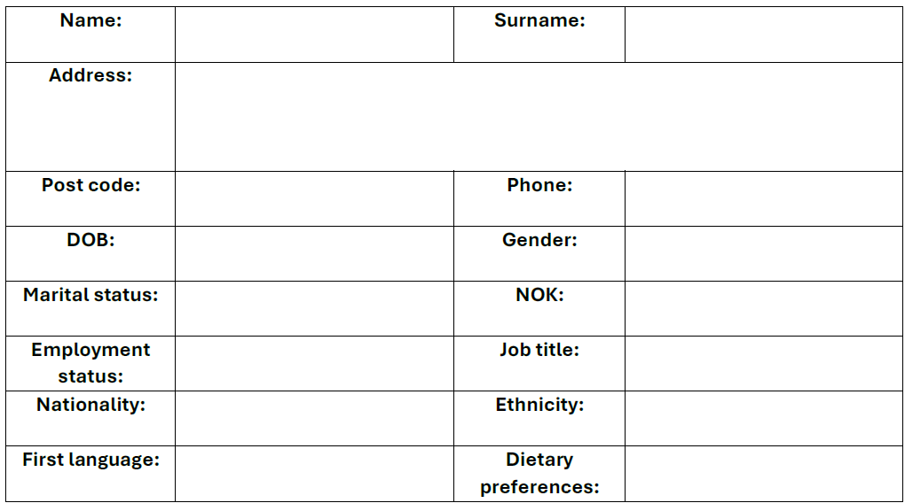
Task 1: Fill your personal details in the table below.

Slide 8
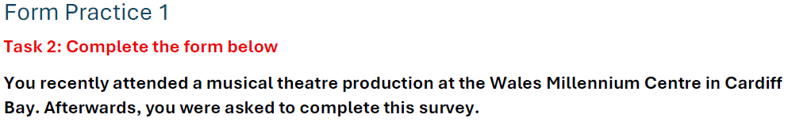
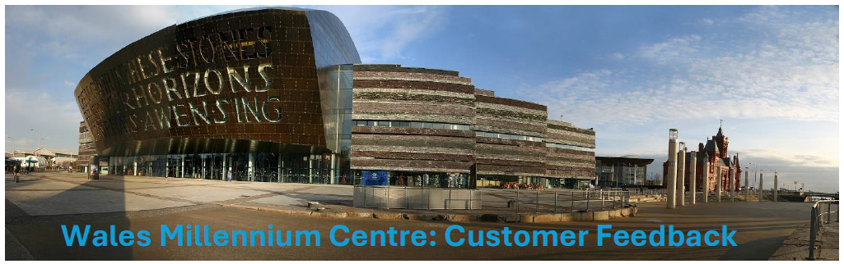

Slide 9
Which of the following shows did you see on your visit today? (Tick one.)
□ Branwen: Dadeni □ Hamilton □ Mamma Mia
□ Cats □ Les Miserables □ The Lion King
Which performance did you watch? (Please underline.)
14:00 showing 20:00 showing
How often do you attend the theatre? (Delete as appropriate.)
Never Rarely Sometimes Often Always
On a scale of 1 (low) to 10 (high), how much did you enjoy today’s performance? (Please circle.)
1 … 2 … 3 … 4 … 5 … 6 … 7 … 8 … 9 … 10

Slide 10
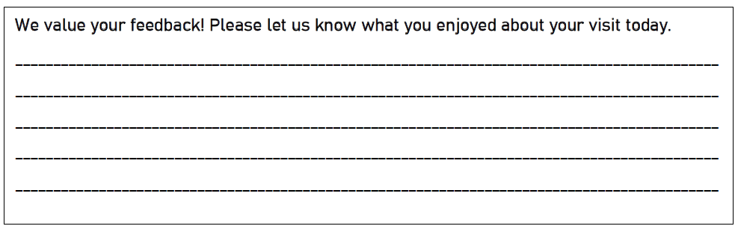


Slide 11
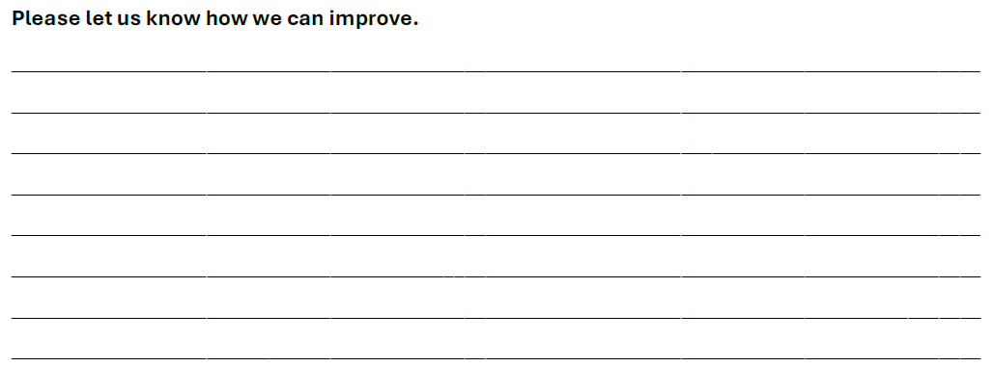

Slide 12
Use topic sentences and write to them.
Useful language
In keeping with
It was shown in a slightly edited form, and I would preferred to have seen a version closer to the original Broadway production. Certainly, both the stage and auditorium are large enough to host such a production.
The seats need to be replaced with more suitable ones in keeping with the quality expected of a modern venue.

Slide 13
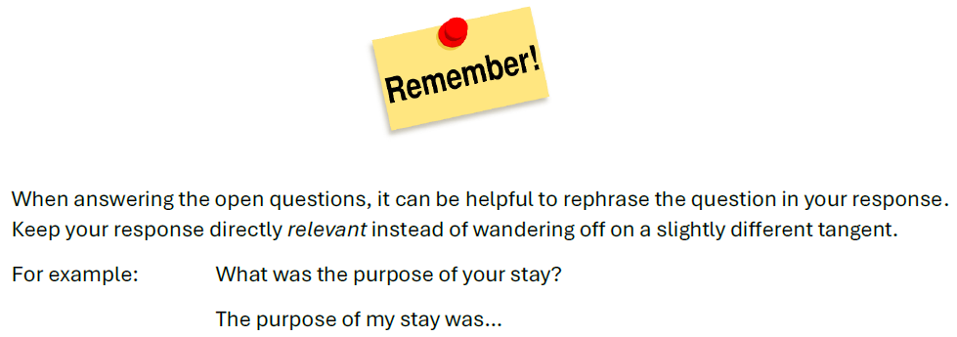


Slide 14
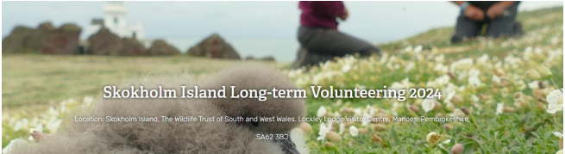
Form Practice 2 Task 3: Complete the form below
You are applying for a volunteer role with a charity that looks after wildlife in West Wales. In this position, you would live for four months on Skokholm Island helping the wardens manage the island and monitor the wild animals.
In the Bristol Channel, which is the area of sea you can see from Cardiff Bay, there are two islands called Flatholm and Steepholm. (See next slide). Anyone can visit Flatholm as a tourist, but the only way you can visit Steepholm legally is my doing exactly this type of job. This is fictional, so, you say you have been a wildlife warden on Steepholm in the appropriate place in your application. Just don’t lie on application forms in real life!!!

Slide 15
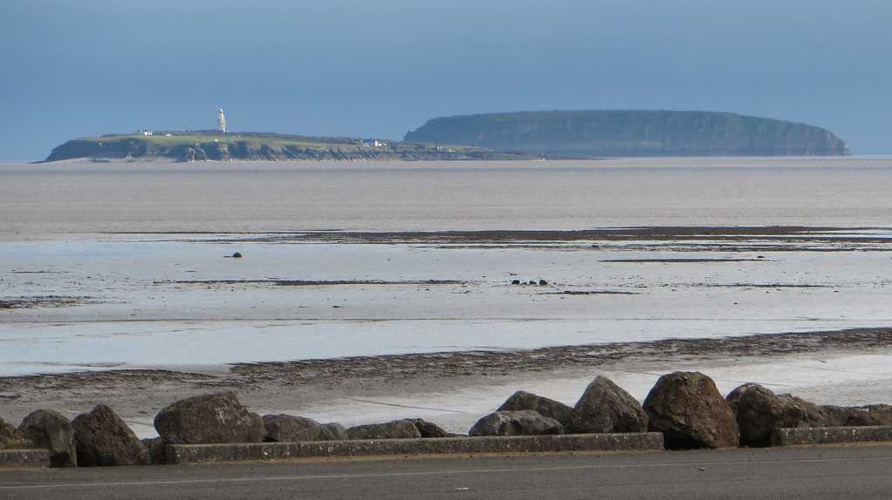
Flatholm
Steepholm

Slide 16
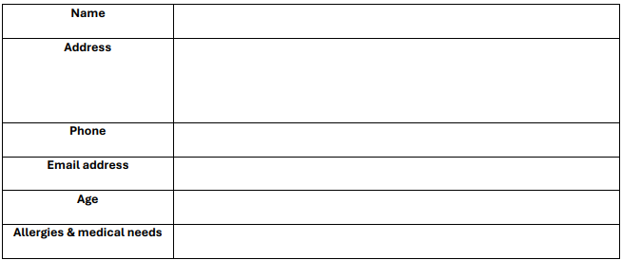
Section 1

Slide 17
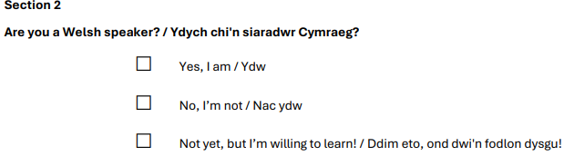
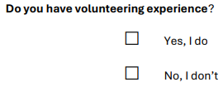

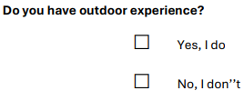

Slide 18

Section 3 Why are you interested in volunteering with the Wildlife Trust?

Slide 19
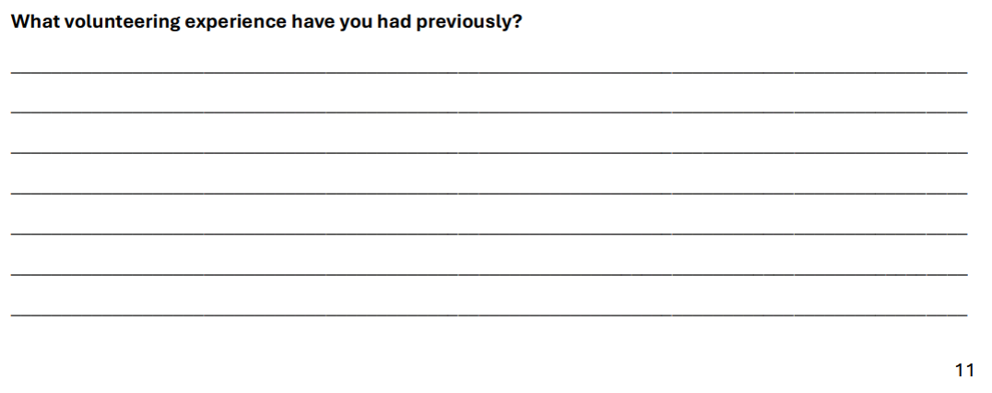

Slide 20
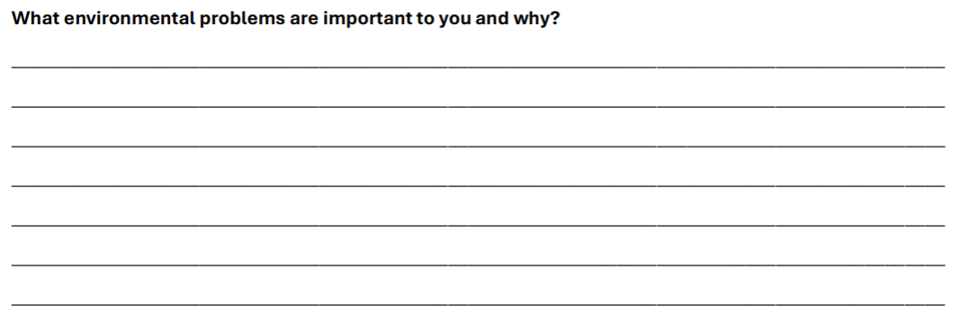

Slide 21
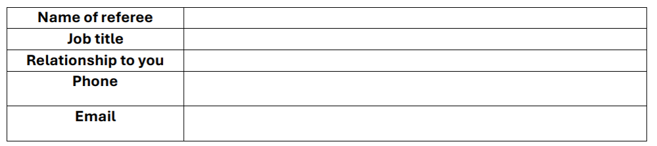
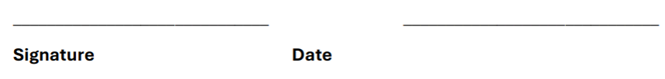

Slide 22


Slide 23
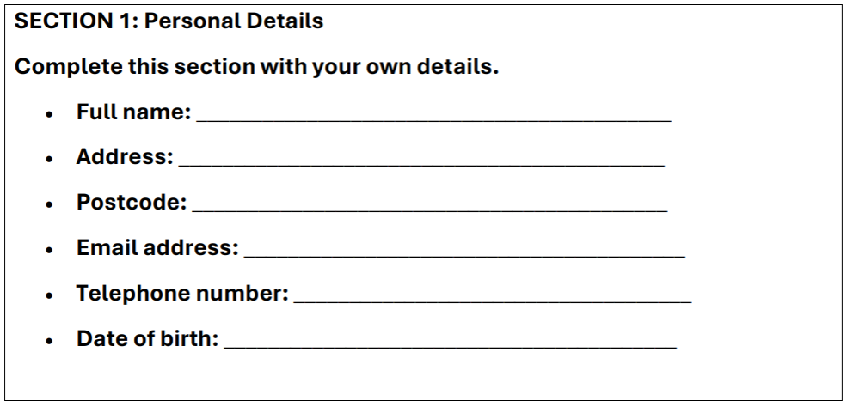

Slide 24
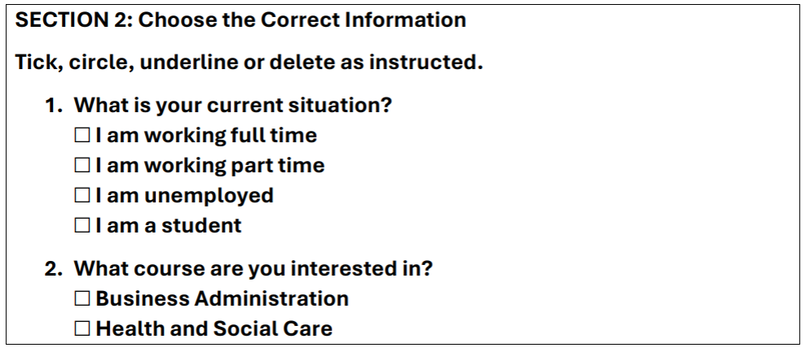
13

Slide 25
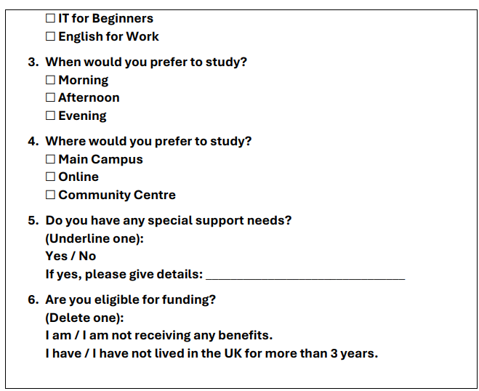

Slide 26
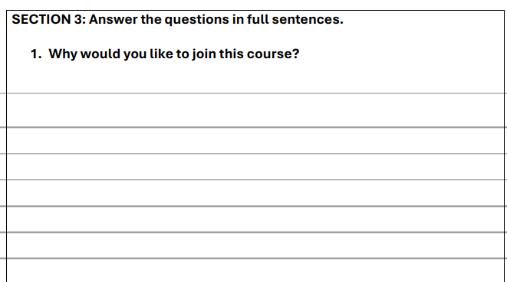
14

Slide 27
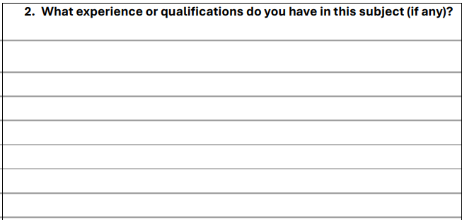

Slide 28
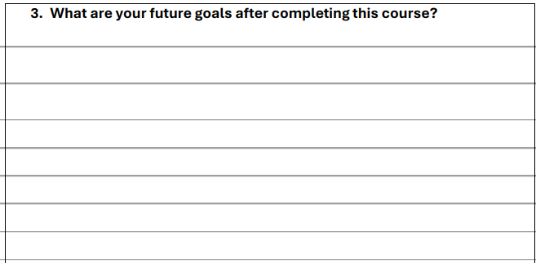

Slide 29
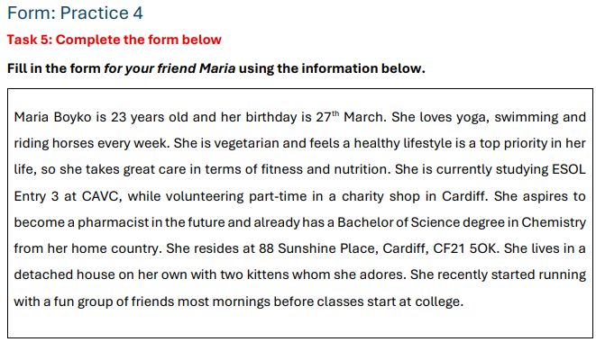

Slide 30
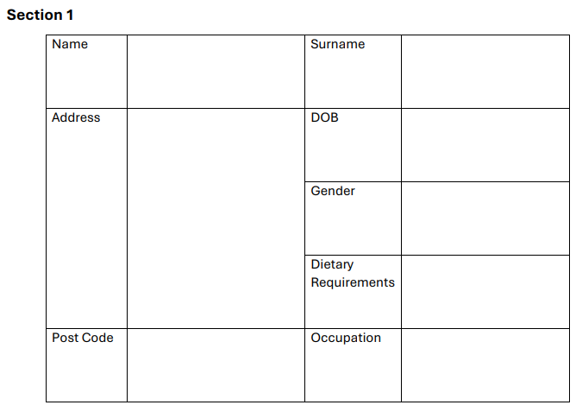

Slide 31
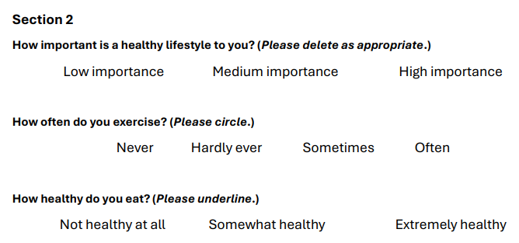

Slide 32
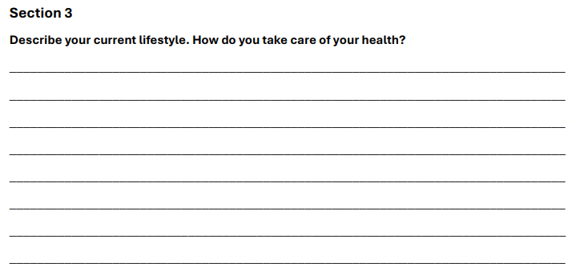

Slide 33

17

